Slide 1
CAPSTONE PROJECT
SQL
PYTHON
TABLEAUE
MENTOR NAME : JAYA PANDEY
STUDENT NAME : AVINAASH ALFRED.R

Slide 2
CONTENTS FOR TABLEAUE
INTRODUCTION
OBJECTIVES
DATA CLEANING
INTERPRETATION
VISUALIZATION OF TABLEUAE
DASHBOARD
CONCLUSION

Slide 3
INTRODUCTION
Exploring Customer Behavior and Churn Patterns in the Banking Sector
In today's competitive banking industry, understanding customer behavior and identifying potential churn patterns are crucial for maintaining a stable and loyal customer base. This interactive dashboard aims to provide comprehensive insights into key factors influencing customer attrition, demographic trends, transaction patterns, and the relationship between various customer attributes.
Through a detailed analysis of the provided dataset, we aim to shed light on significant trends and correlations that can aid in strategic decision-making and the development of effective retention strategies. By examining various aspects of customer data, such as gender distribution, income categories, card usage patterns, and interactions with the banking services, this dashboard serves as a valuable tool for banking professionals seeking to optimize customer retention and enhance overall customer experience.
By leveraging the interactive capabilities of this dashboard, users can delve deeper into the underlying data and uncover actionable insights that can drive targeted marketing campaigns, personalized customer engagement, and the development of tailored financial products and services. With a focus on empowering data-driven decision-making, this dashboard acts as a valuable resource for understanding the dynamics of customer relationships and addressing potential challenges related to customer churn in the banking sector.

Slide 4
OBJECTIVES
Customer Segmentation: Identify distinct customer segments based on demographic factors, such as gender, age, and income, to understand their preferences and behavior patterns.
Churn Prediction: Analyze churn rates based on various customer attributes and interactions with banking services to identify potential churn patterns and factors contributing to customer attrition.
Behavioral Analysis: Explore transactional behavior, such as total transaction amounts and card usage patterns, to gain insights into customer preferences and engagement with the banking products and services.
Retention Strategy Development: Use the identified insights to develop targeted retention strategies and personalized customer engagement initiatives aimed at reducing churn and enhancing overall customer satisfaction and loyalty.
Performance Evaluation: Assess the performance of different card categories and their impact on customer engagement and satisfaction, enabling the identification of areas for improvement and optimization.
Customer Experience Enhancement: Understand the relationship between customer age, credit limit, and usage patterns to improve the overall customer experience and tailor financial products and services to meet specific customer needs.
Data-Driven Decision-Making: Enable data-driven decision-making by providing actionable insights that can guide strategic planning, marketing campaigns, and product development initiatives within the banking sector.

Slide 5
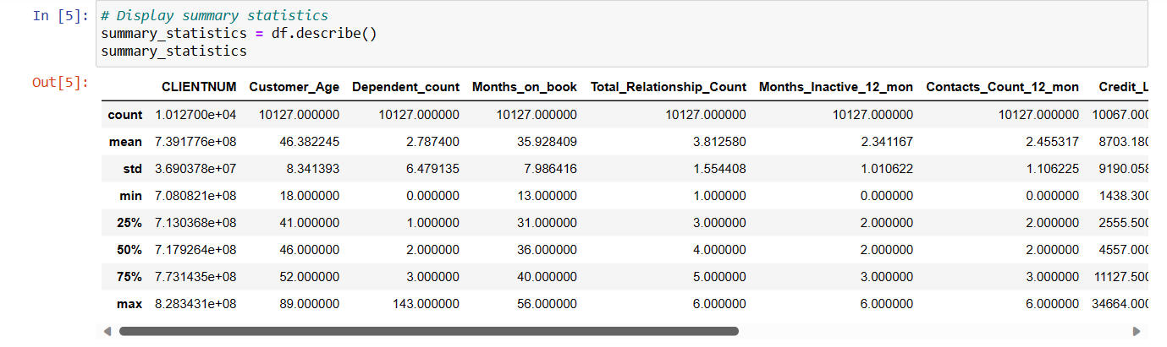
DATA CLEANING 1.SUMMARZING THE DATA
INTERPRETATION
1. The describe() function provides a comprehensive overview of the numerical columns in the dataset, including count, mean, standard deviation, minimum, and maximum values, as well as various quartiles.
Count: This indicates the number of non-null values for each column. If any columns have significantly lower counts, it might suggest missing data or potential data quality issues.
Mean: The mean gives an idea of the central tendency of the data, providing an average value for each numerical column. For example, the mean of a certain attribute might indicate the typical value observed in the dataset.
Standard Deviation: The standard deviation measures the dispersion or spread of the data. A high standard deviation suggests that the data points are spread out over a wider range, indicating higher variability.
Minimum and Maximum Values: These represent the lowest and highest values in each numerical column, respectively. Understanding these values is important to identify the range within which the data is distributed.
Quartiles (25%, 50%, 75%): These values represent the data points that divide the dataset into four equal parts. The 50% quartile (median) indicates the middle value, while the 25% and 75% quartiles represent the first and third quartiles, respectively. These quartiles provide insights into the spread and distribution of the data

Slide 6
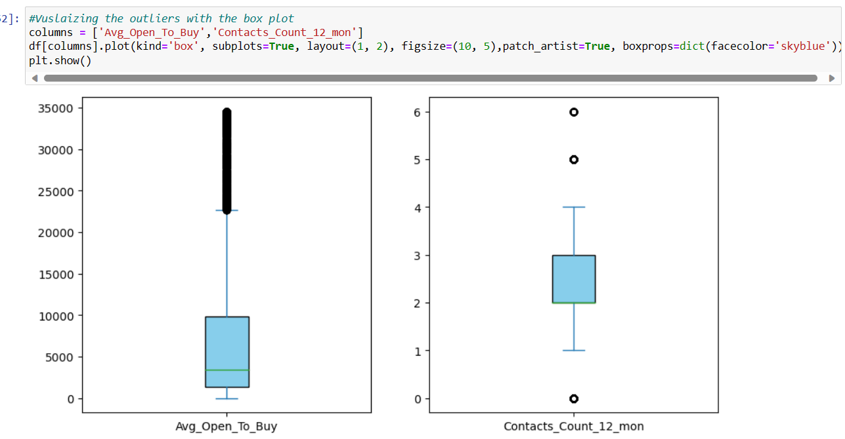
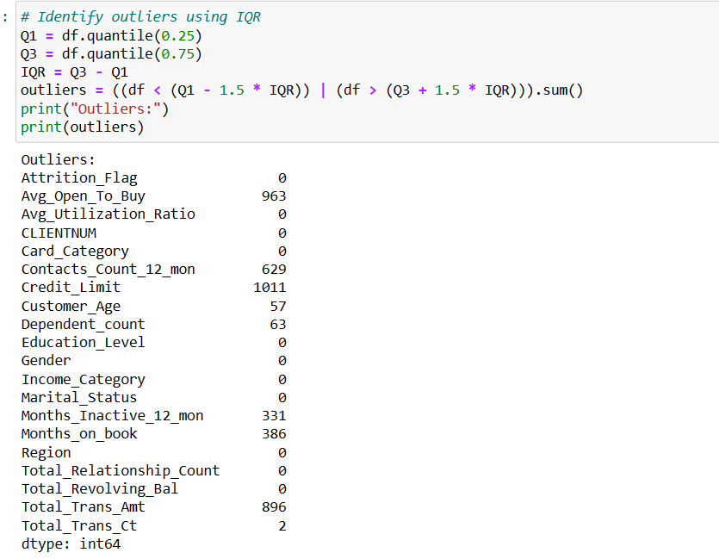
DATA CLEANING PERFORMING OUTLIER ANALYSIS
INTERPRETATION:
1.Identifying the outliers by using IQR method
2.Visulaize the outliers using box for the required numerical columns which has outliers

Slide 7
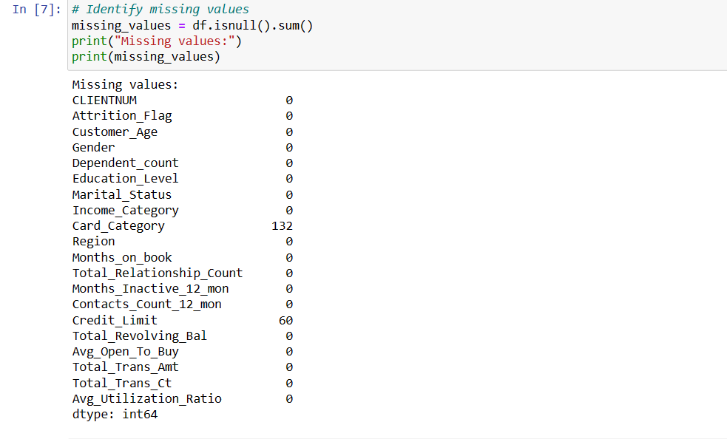
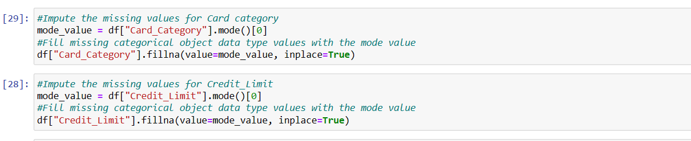
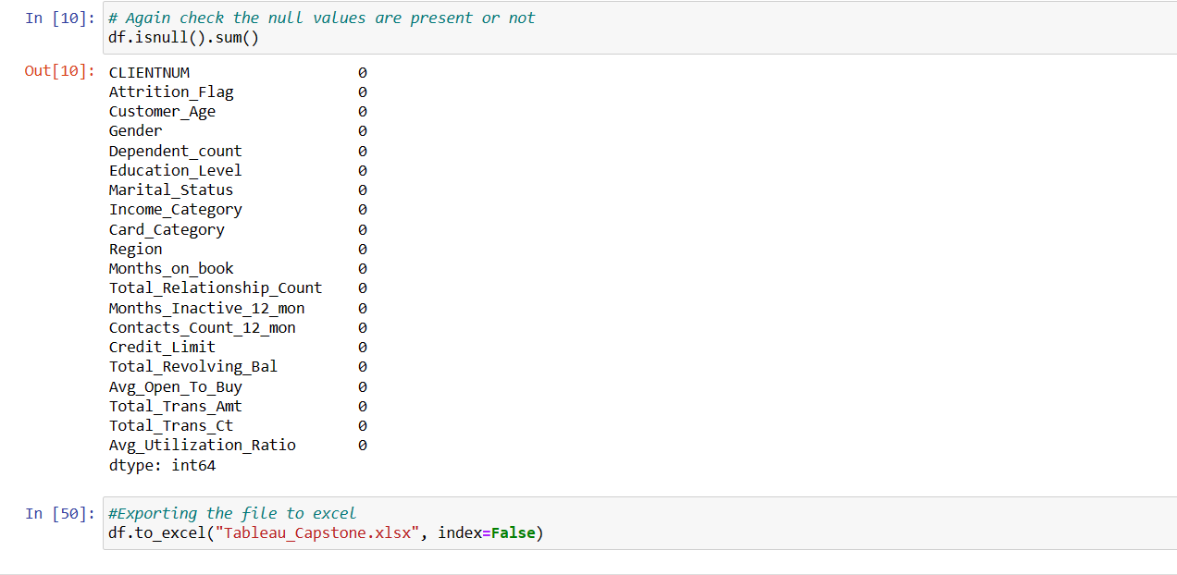
DATA CLEANING IMPUTING THE MISSING VALUES AND EXPORTING THE CLEANED DATA
INTERPRETATION
1.Data Imputation: For data imputation, you can use methods such as mean, median, or mode, depending on the nature of the data. Here's an example of how to impute missing values using the mean
2.After imputing export the cleaned data and convert it into excel
Using #Exporting the file to excel
df.to_excel("Tableau_Capstone.xlsx", index=False)

Slide 8
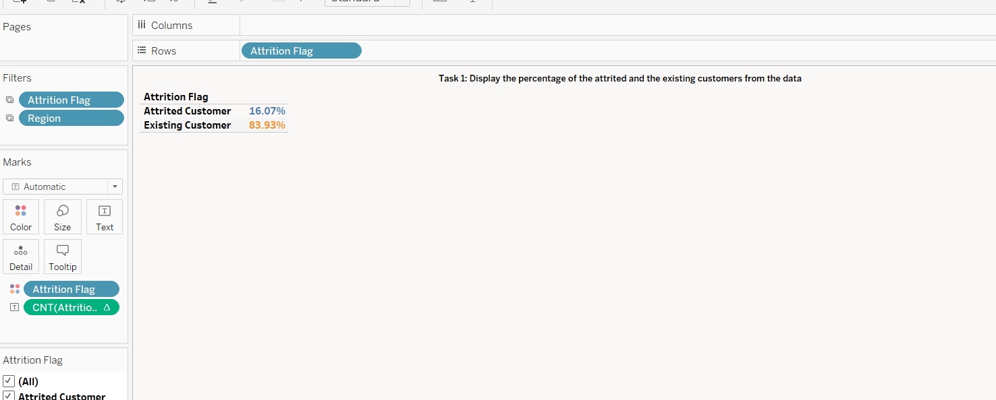
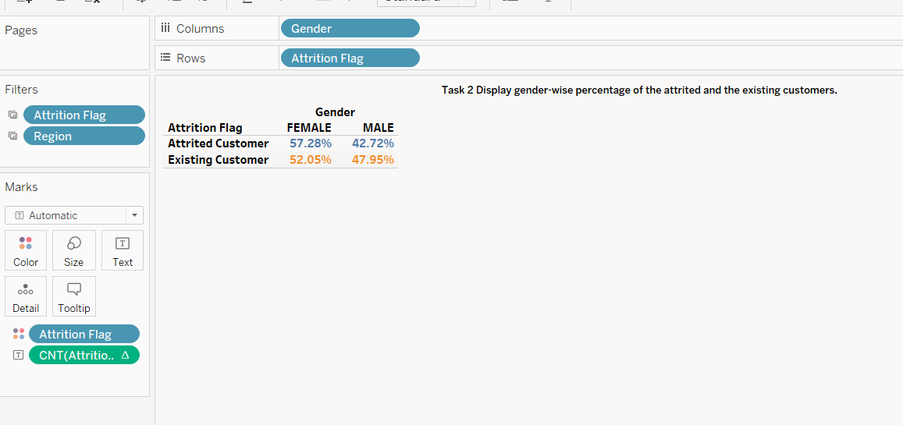
VISUALIZATION OF TABLEUAE
TASK1:Display the percentage of the attired and the existing customers from the data
TASK2:Display gender-wise percentage of the attired and the existing customers.
INTERPRETATION
1.Percentage of Total Count of Attrition Flag broken down by Attrition Flag. Color shows details about Attrition Flag. The data is filtered on Region, which keeps England, Northern Ireland, Scotland and Wales. The view is filtered on Attrition Flag, which keeps Attired Customer and Existing Customer.
2.Attrited customer has 16.07% And Exisiting customer has 83.93%
INTERPRETATION:
1.Percentage of Total Count of Attrition Flag broken down by Gender vs. Attrition Flag. Color shows details about Attrition Flag. The data is filtered on Region, which keeps England, Northern Ireland, Scotland and Wales. The view is filtered on Attrition Flag, which keeps Attired Customer and Existing Customer.
2. As per the analysis Attired customer has 57.28% of female and 42.72%of male
and Exisiting customer has 52.05%of female and 47.95%of male

Slide 9
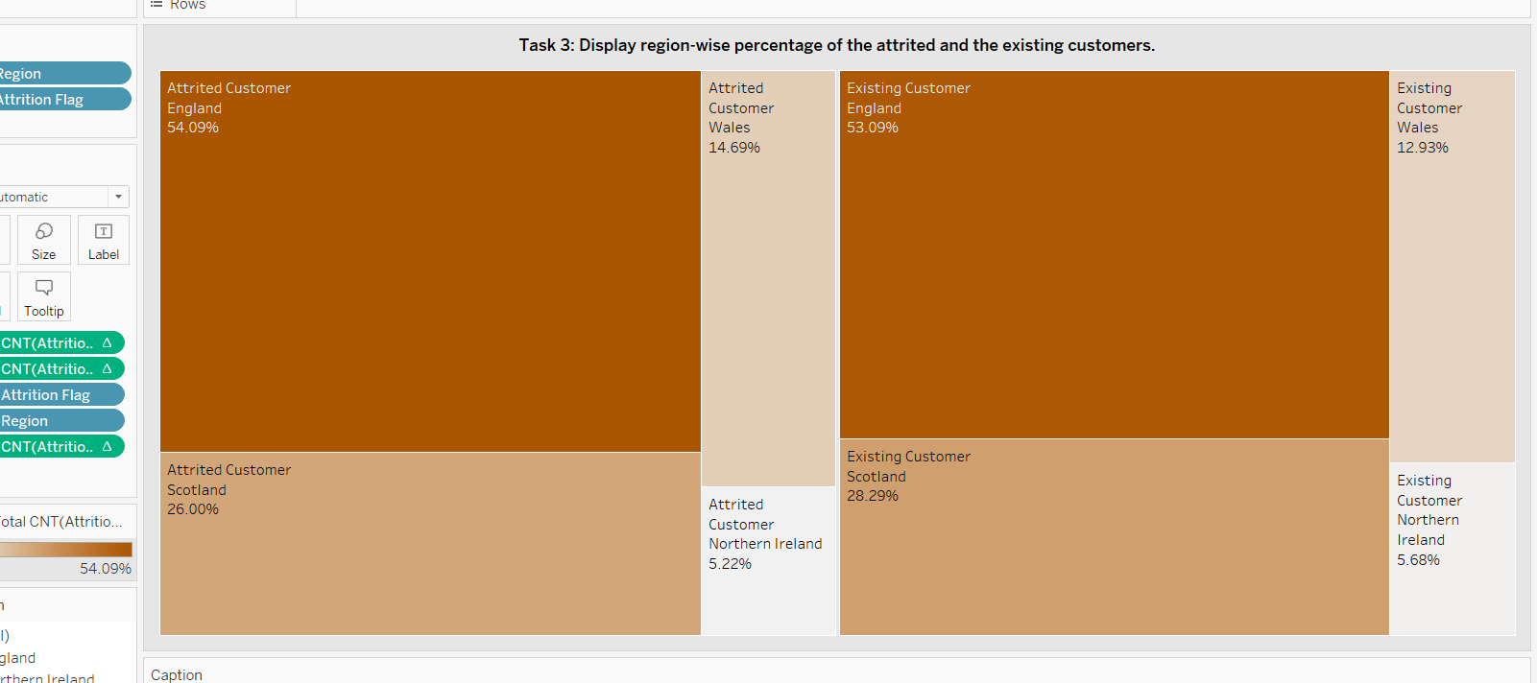
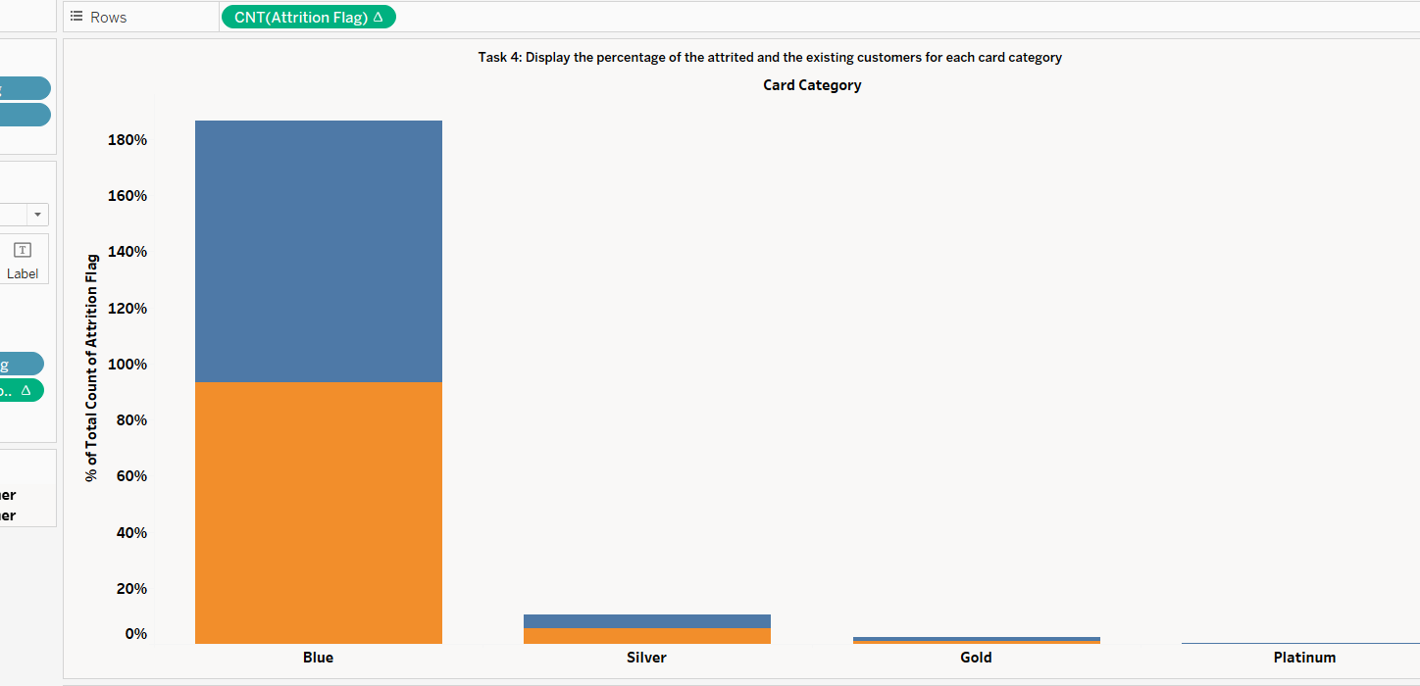
VISUALIZATION OF TABLEUAE
TASK3: Display region-wise percentage of the attired and the existing customers.
TASK4: Display the percentage of the attired and the existing customers for each card category
INTERPRETATION:
Attrition Flag, Region and % of Total Count of Attrition Flag. Color shows % of Total Count of Attrition Flag. Size shows % of Total Count of Attrition Flag. The marks are labeled by Attrition Flag, Region and % of Total Count of Attrition Flag. The view is filtered on Region and Attrition Flag. The Region filter keeps England, Northern Ireland, Scotland and Wales. The Attrition Flag filter keeps Attired Customer and Existing Customer.
2.Region-wise percentage has been displayed using Tree graph
INTERPRETATION:
1.Precentage of Total Count of Attrition Flag for each Card Category. Color shows details about Attrition Flag. The data is filtered on Region, which keeps England, Northern Ireland, Scotland and Wales. The view is filtered on Attrition Flag, which keeps Attired Customer and Existing Customer.
2.As per the analysis blue has the highest percentage among all the card category for the attriited and existing customers

Slide 10
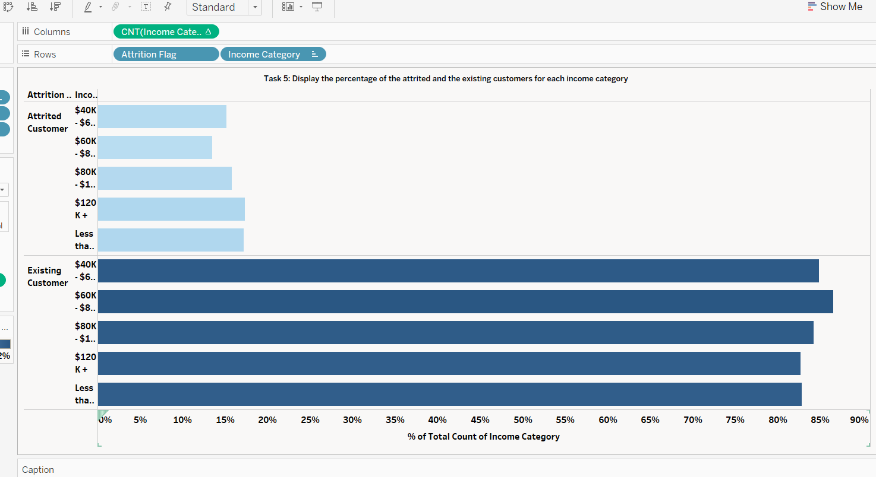
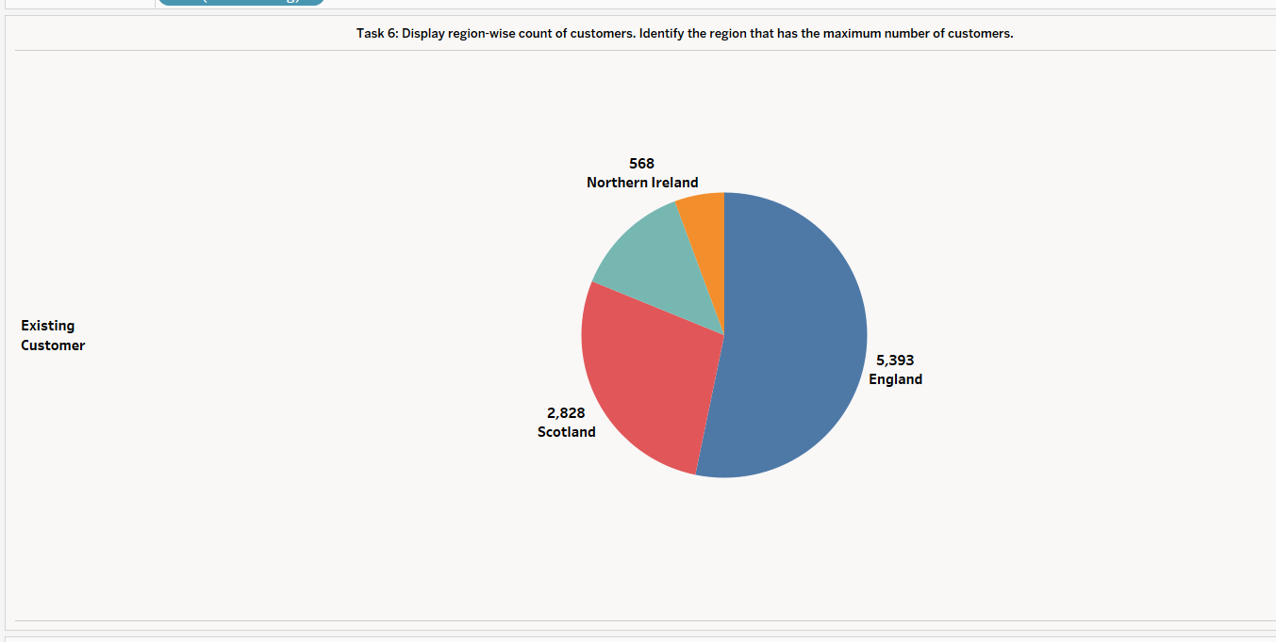
VISUALIZATION OF TABLEUAE
TASK5:Display the percentage of the attired and the existing customers for each income category
TASK6:Task 6: Display region-wise count of customers. Identify the region that has the maximum number of customers.
INTERPRETATION
1.Count of Attrition Flag and Region broken down by maximum of Attrition Flag. Color shows details about Region. Size shows count of Attrition Flag. The marks are labeled by count of Attrition Flag and Region. The data is filtered on Attrition Flag, which keeps Attired Customer and Existing Customer. The view is filtered on Region, which keeps England, Northern Ireland, Scotland and Wales.
2.As per the analysis England has the highest number of customers
INTERPRETATION:
Percentage of Total Count of Income Category for each Income Category broken down by Attrition Flag. Color shows % of Total Count of Income Category. The data is filtered on Region, which keeps England, Northern Ireland, Scotland and Wales. The view is filtered on Income Category and Attrition Flag. The Income Category filter keeps $120K +, $40K - $60K, $60K - $80K, $80K - $120K and Less than $40K. The Attrition Flag filter keeps Attired Customer and Existing Customer.

Slide 11
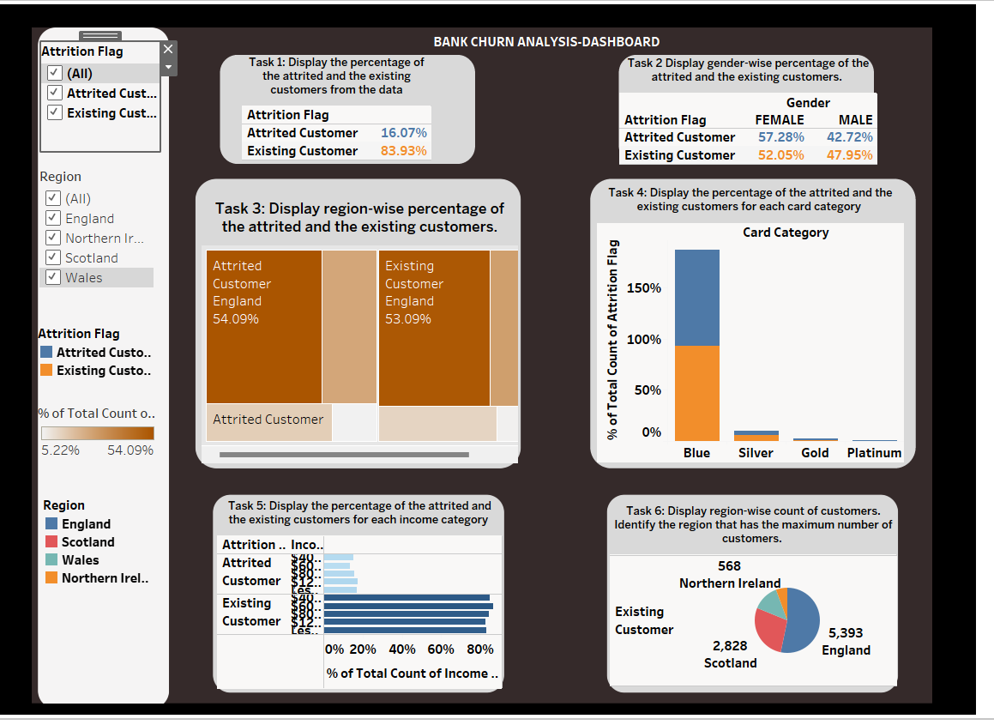
DASHBOARD-BANK CHURN ANALYSIS
HIDDEN INTERPRETATION:
This hidden interpretation emphasizes the potential for targeted strategies to capture the high-income customer segment, highlighting the importance of tailored services and exclusive offerings to enhance customer engagement and loyalty within this specific demographic group. By recognizing this hidden opportunity, the banking institution can optimize its approach and maximize its market potential, ultimately leading to improved customer retention and long-term profitability.

Slide 12
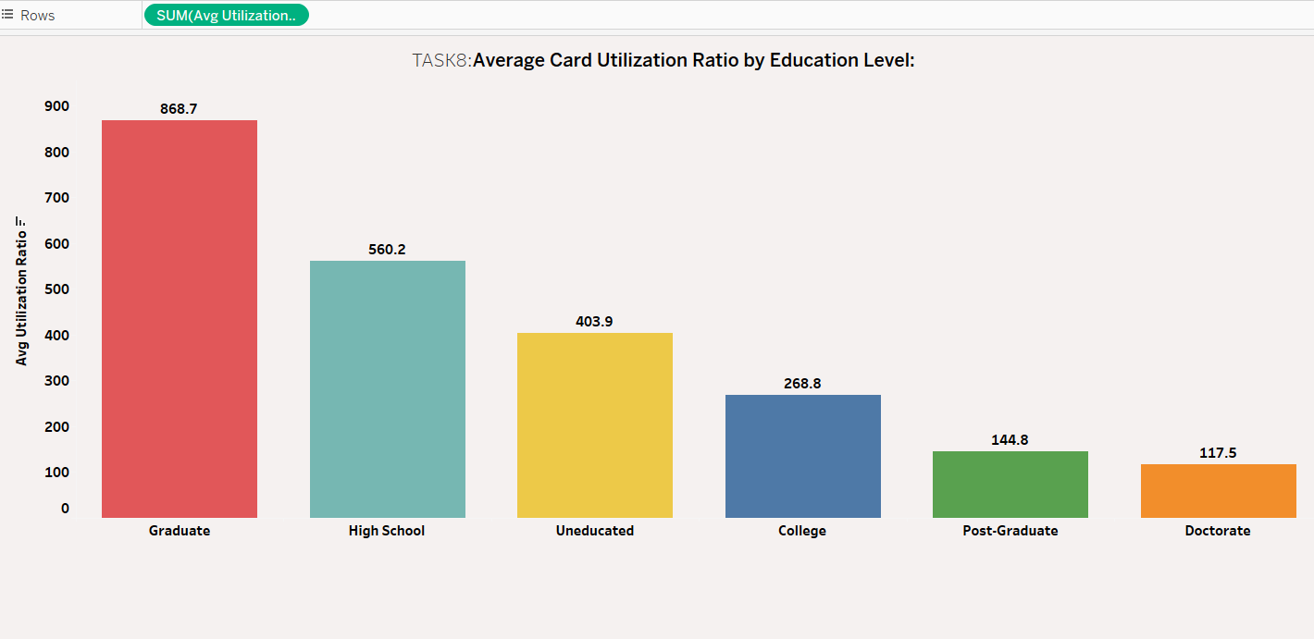
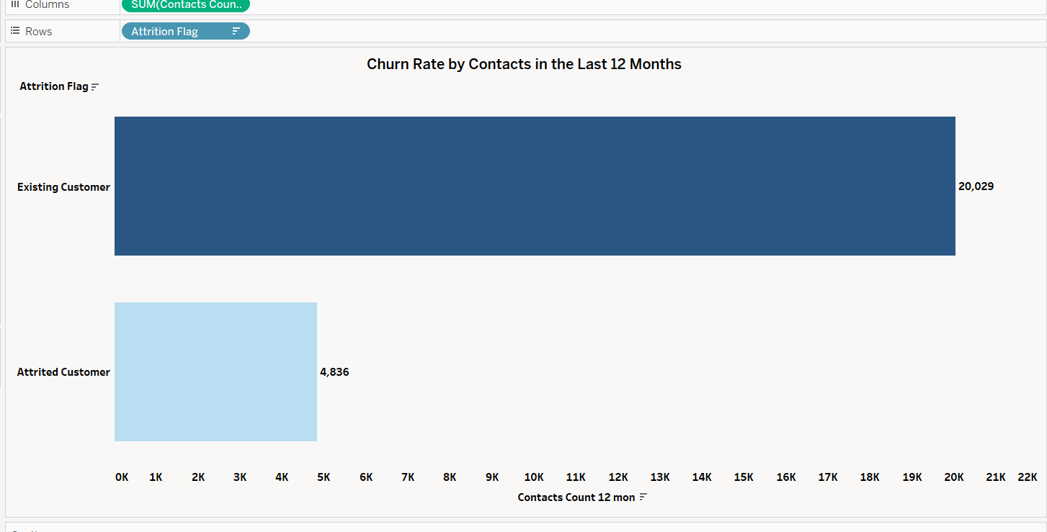
TASK8:EXTRA OBSERVATION
TASK8.1:Average Card Utilization Ratio by Education Level:
TASK8.2:Churn Rate by Contacts in the Last 12 Months
INTERPRETATION:
1.Sum of Avg Utilization Ratio for each Education Level. Color shows details about Education Level. The marks are labeled by sum of Avg Utilization Ratio. The data is filtered on Attrition Flag, which keeps Attired Customer and Existing Customer. The view is filtered on Education Level, which excludes Unknown.
2.As per the analysis Graduate has the highest Average
INTERPRETATION:
1.Sum of Contacts Count 12 Mon for each Attrition Flag. Color shows sum of Contacts Count 12 mon. The marks are labeled by sum of Contacts Count 12 mon. The view is filtered on Attrition Flag, which keeps Attired Customer and Existing Customer.
2.As per the analysis Existing customer has the highest churn rate of 20,029

Slide 13
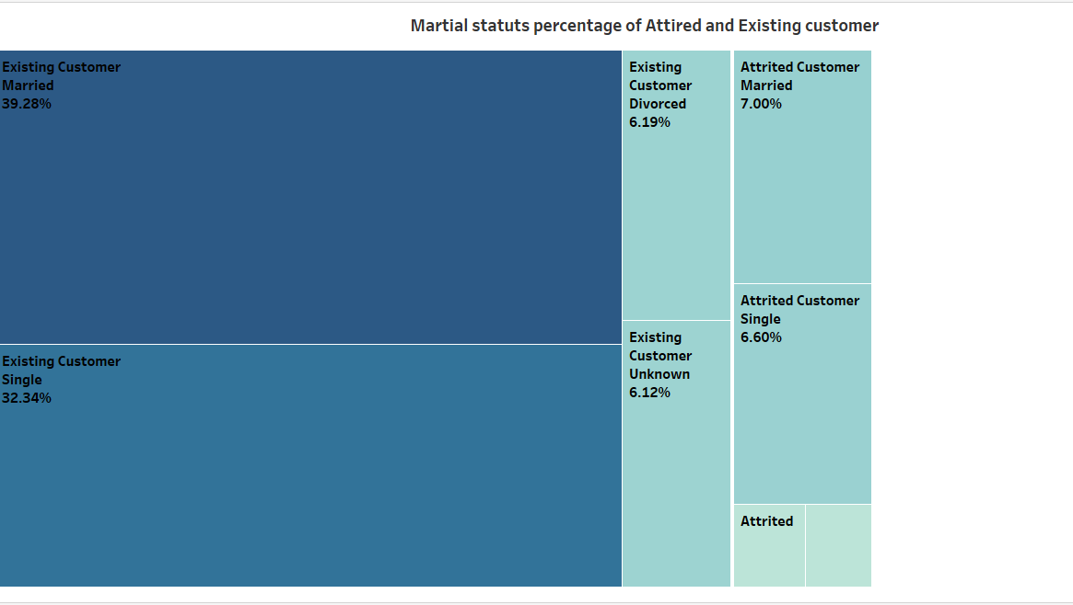
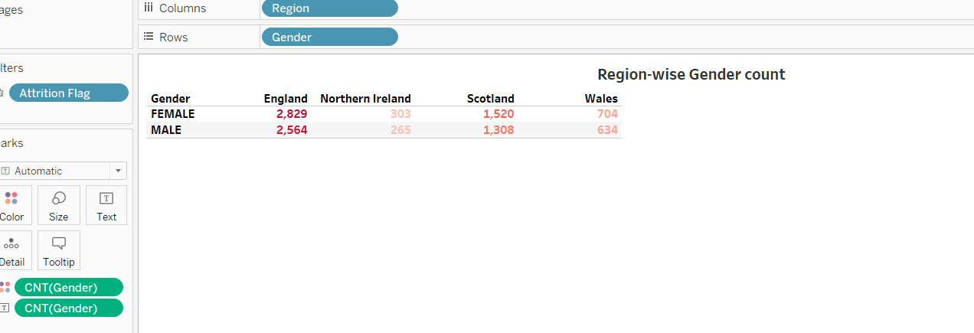
EXTRA OBSERVATION
TASK8.4:Martial status percentage of Attired and Existing customer
TASK8.3:Region-wise Gender count
INTERPRETATION
1.Count of Gender broken down by Region vs. Gender. Color shows count of Gender. The data is filtered on Attrition Flag, which keeps Attired Customer and Existing Customer.
2.England has the highest count among all the region
INTERPRETATION
1.Attrition Flag, Marital Status and % of Total Count of Marital Status. Color shows count of Marital Status. Size shows count of Marital Status. The marks are labeled by Attrition Flag, Marital Status and % of Total Count of Marital Status. The view is filtered on Attrition Flag, which keeps Attired Customer and Existing Customer.
2.It is visualized using tree map

Slide 14
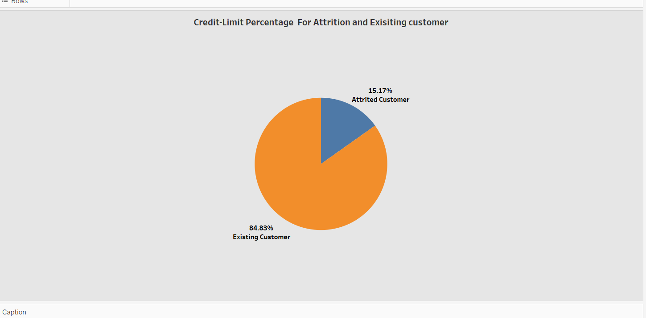
EXTRA OBERVATION
INTERPRETATION
1.Percentage of Total Credit Limit and Attrition Flag. Color shows details about Attrition Flag. Size shows % of Total Credit Limit. The marks are labeled by % of Total Credit Limit and Attrition Flag. The view is filtered on Attrition Flag, which keeps Attrited Customer and Existing Customer.
Credit-Limit Percentage For Attrition and Exisiting customer

Slide 15
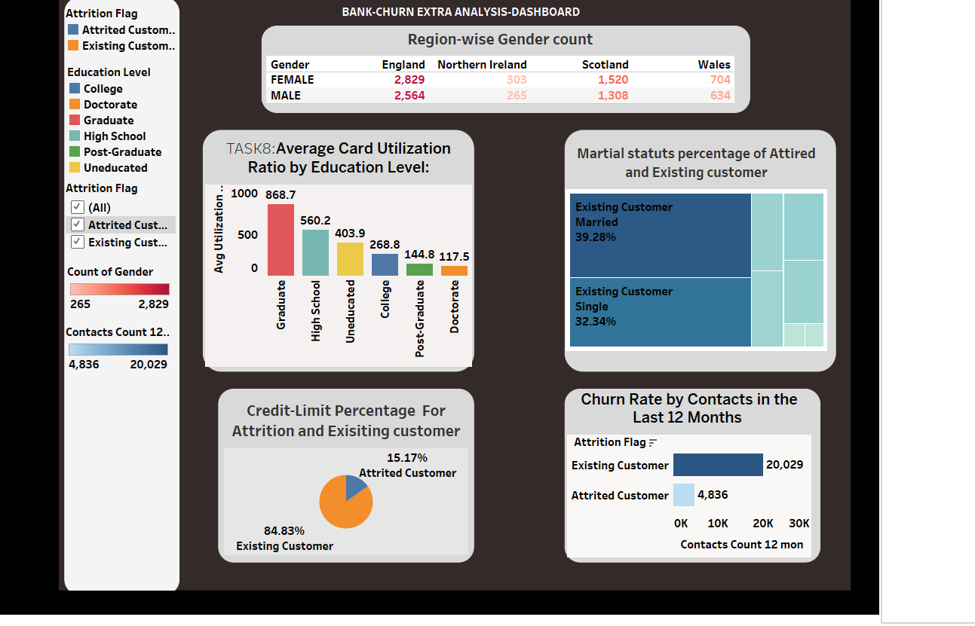
DASHBOARD-FOR EXTRA OBERSAVTION

Slide 16
CONCLUSION
Through an in-depth exploration of the interactive dashboard, several crucial insights have emerged, shedding light on the dynamics of customer behavior and churn patterns within the banking sector. The analysis has highlighted the significance of various factors, including demographic trends, transactional behavior, and customer interactions, in influencing customer retention and satisfaction.
Key findings from the analysis include the identification of specific customer segments based on demographic attributes, allowing for the customization of tailored retention strategies and personalized customer engagement initiatives. Furthermore, the analysis has revealed correlations between customer churn rates and factors such as the frequency of contacts, highlighting the importance of maintaining optimal communication with customers to reduce churn.
Moreover, a detailed examination of transaction patterns and card usage has provided valuable insights into customer preferences and engagement with banking services, enabling the formulation of targeted marketing campaigns and the development of enhanced financial products and services to meet customer needs more effectively.
By leveraging the power of data-driven decision-making, the insights derived from this dashboard analysis serve as a cornerstone for the development of robust customer retention strategies, aiming to foster long-term customer loyalty and satisfaction within the competitive landscape of the banking industry.

Slide 17
THANK YOU

